Slide 1

Data Analysis Lab
Ian Wang
Ayaan Sunesara

Slide 2

Overview
If the size of the country/region in square kilometers increases, then the amount of internet access increases.

Slide 3

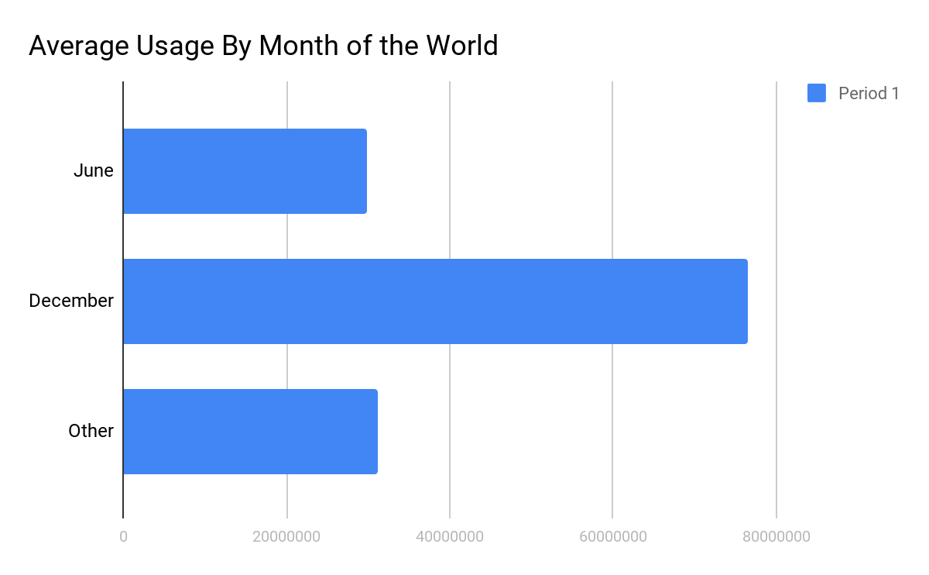
Question 1
Does the date of data records affect the rest of the statistics? (December vs June records).
December | 451261200
June | 264210000
Other | 321000000

Slide 4
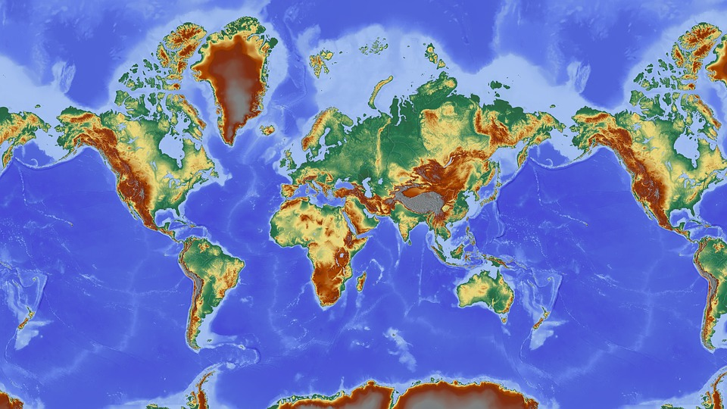
Question 2
Does the size of the country/region affect the size of the population within?
Size | Larger | Smaller
Population | More | Less

Slide 5
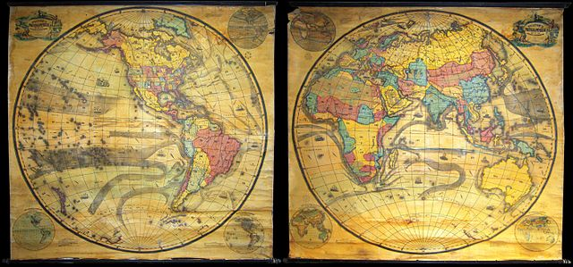
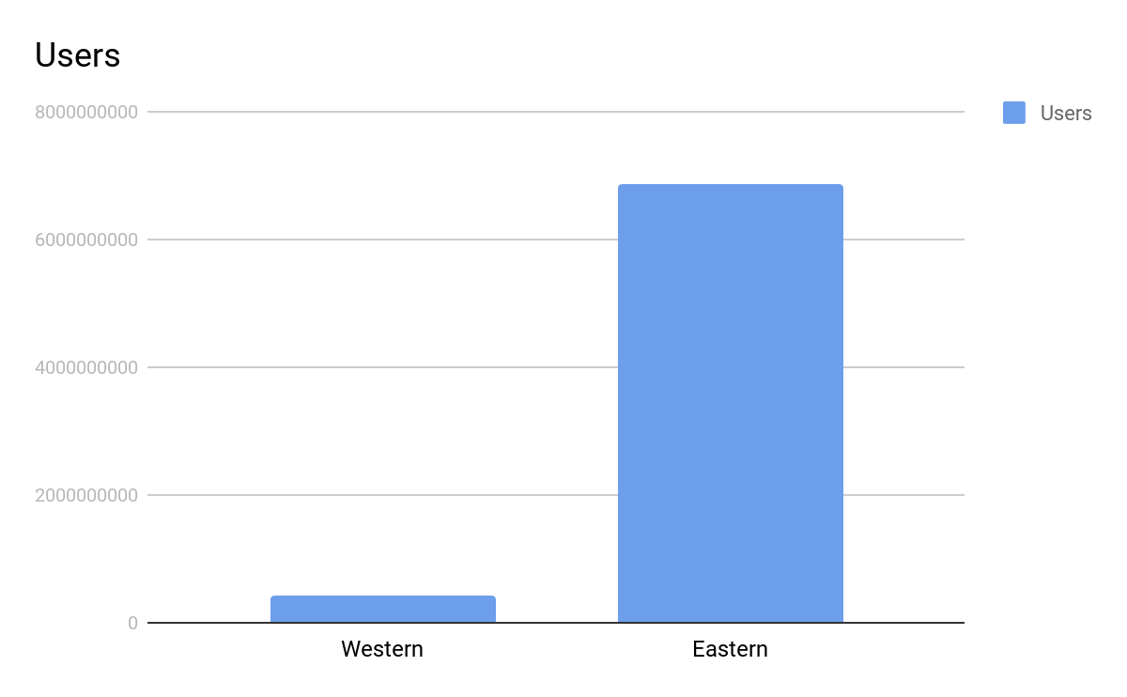
Question 3
What is the difference between the amount of internet users of the Western Hemisphere and the Eastern Hemisphere?

Slide 6
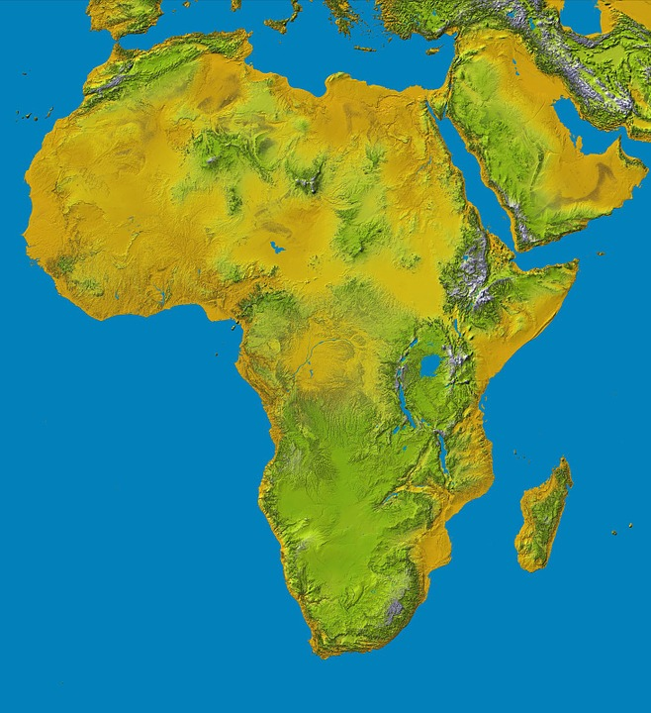
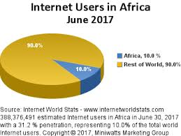
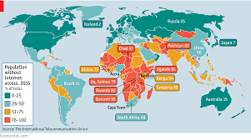
Question 4
Which continent shows the greatest future internet usage growth?
Africa since the beginning of the 21st century has shown the greatest internet usage growth.

Slide 7

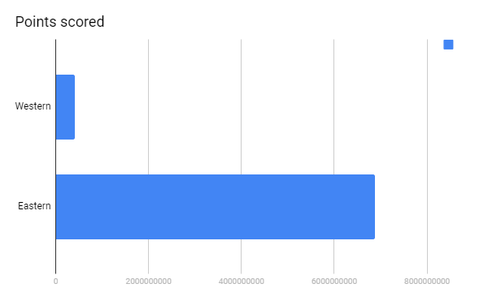
Question 5
How does the population within a country or region affect the amount of internet users within?
The more people there are in a country/region, the more internet users there will be within.

Slide 8

Conclusion
According to the data collected, our thesis has been proven to be accurate; the larger the country or region really does increase the amount of internet users within the country or region.

Slide 9

Credits
Google Images
Wikipedia
Excel Chart

